Slide 1
Principal Component Analysis Applications - Financial Data
Dimitris Koutentakis
18.s096
Final Project Presentation

Slide 2
Principal Component Analysis (PCA)
Orthogonal transformation :
New coordinate system
Correlated variables -> linearly independent
1st component (PC1) largest variance
2nd component (PC2) 2nd largest variance…
Applications:
Simplify data
Compression
Data analysis
Finance

Slide 3
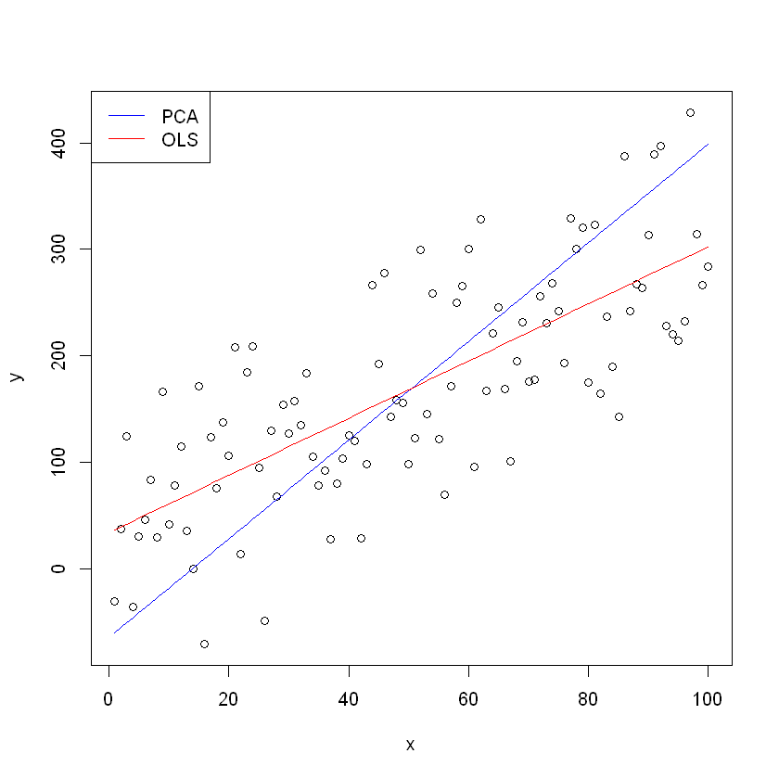
PCA – Geometric Interpretation
Like OLS , but perpendicular instead of vertical
Perpendicular Least Squares
No causal relationship

Slide 4
PCA – steps
Get data – ideally some correlation
“De-mean” – Subtract mean from each dimension
Find covariance matrix of de-meaned data
Find eigenvectors and eigenvalues of cov. Matrix
Order components based on eigenvectors
Transform data: new dimension = (PC) x (de-meaned data)

Slide 5
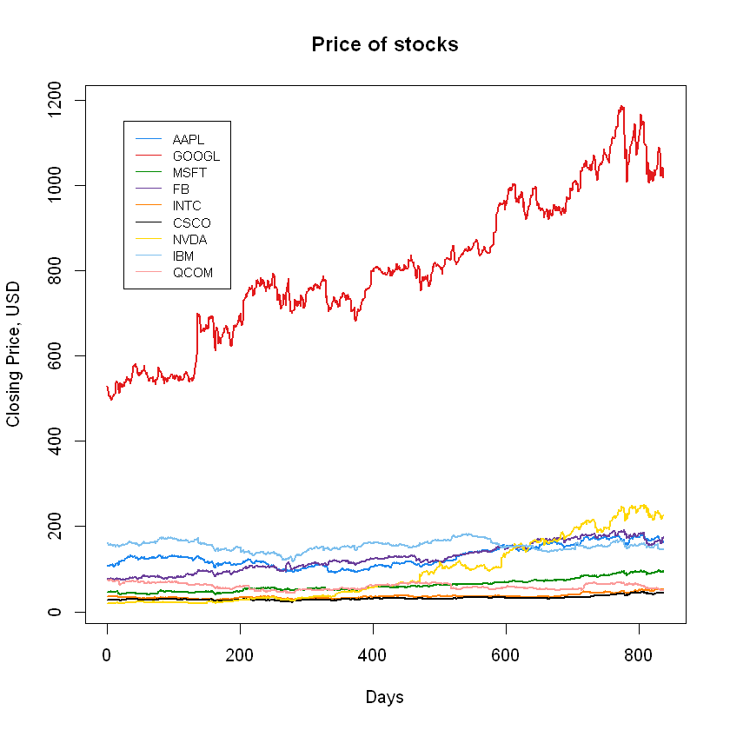
Technology Stocks Application
Technology industry stocks:
Apple, Google, Microsoft, Facebook, Intel, Cisco, Nvidia, IBM, Qualcomm
Jan. 1st 2015 – May 1st 2018

Slide 6
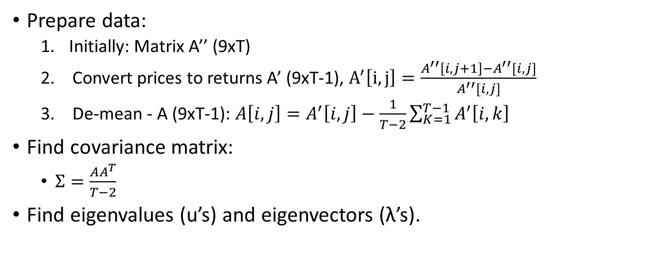
Technology Stocks Application
Prepare data:
Initially: Matrix A’’ (9xT)
Convert prices to returns A’ (9xT-1), $A^{′}\left[i,j\right]=\frac{A^{′′}\left[i,j+1\right]−A^{′′}[i,j]}{A^{′′}[i,j]}$
De-mean - A (9xT-1): $A\left[i,j\right]=A^{′}\left[i,j\right]−\frac{1}{T−2}\sum_{K=1}^{T−1}{A^{′}\left[i,k\right]}$
Find covariance matrix:
$Σ=\frac{AA^{T}}{T−2}$
Find eigenvalues (u’s) and eigenvectors (λ’s).

Slide 7
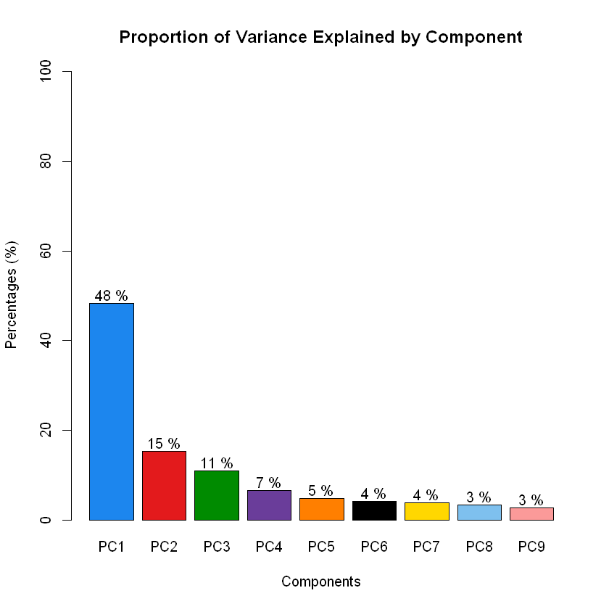
Technology stocks - Results
Some degree of correlation
Mostly explained by top 4 PC’s
Large time-frame in volatile market

Slide 8
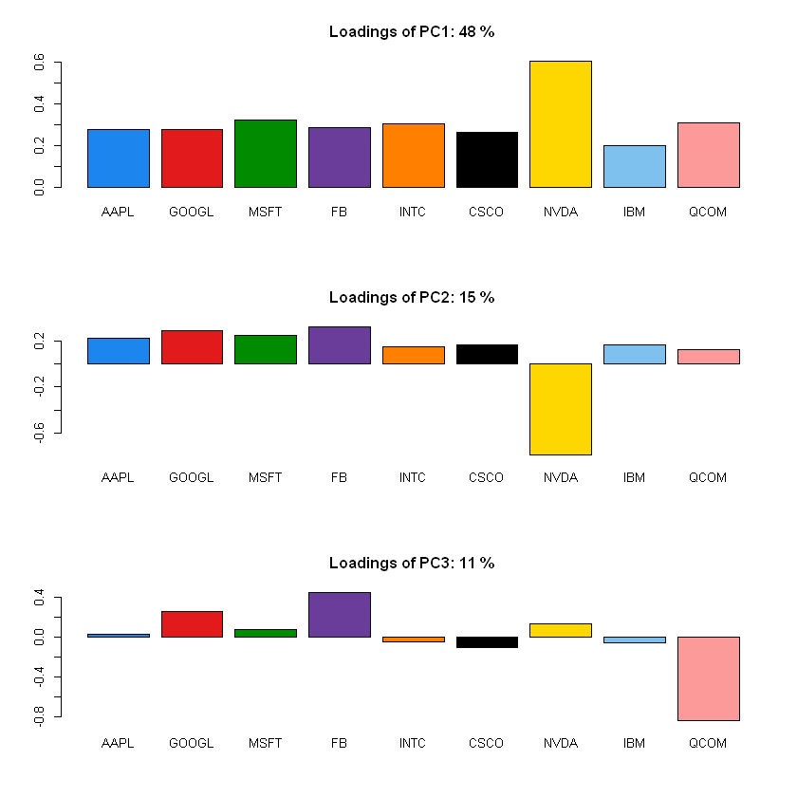
Technology Stocks - Results
First principal component: General technology industry trend
2nd: Technology industry compared to Nvidia
Google and Facebook compared to Qualcomm

Slide 9
Technology Stocks - Stability
“Rolling window” PCA:
Select subset of data from time 0 to time t’
Perform PCA
Move “window” by one day: new subset from time 1 to t’+1
Continue…
1-month windows too noisy
3, 6-month windows are ok

Slide 10
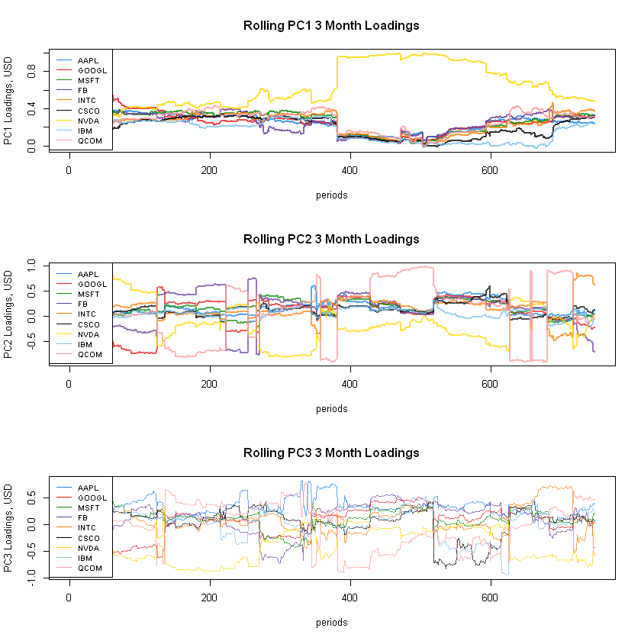
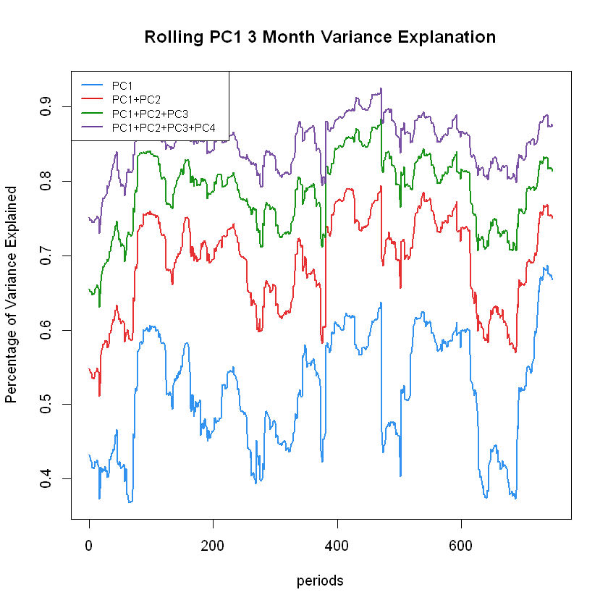
Technology Stocks - Stability

Slide 11
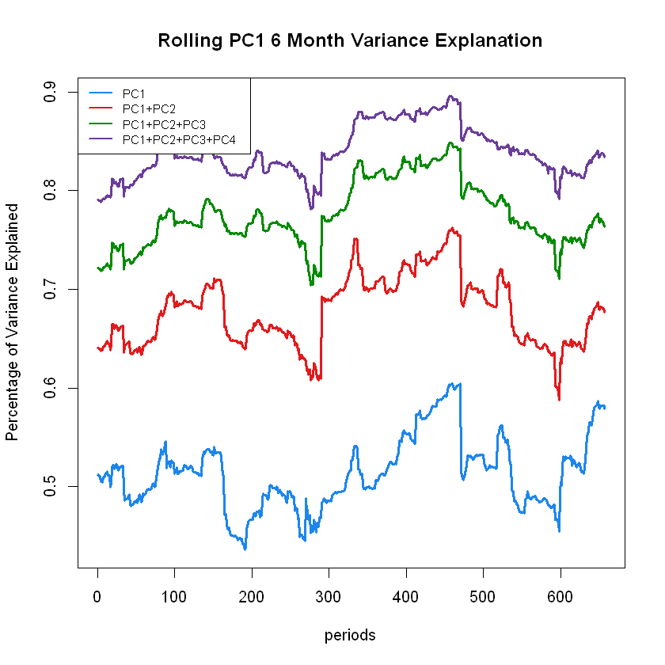
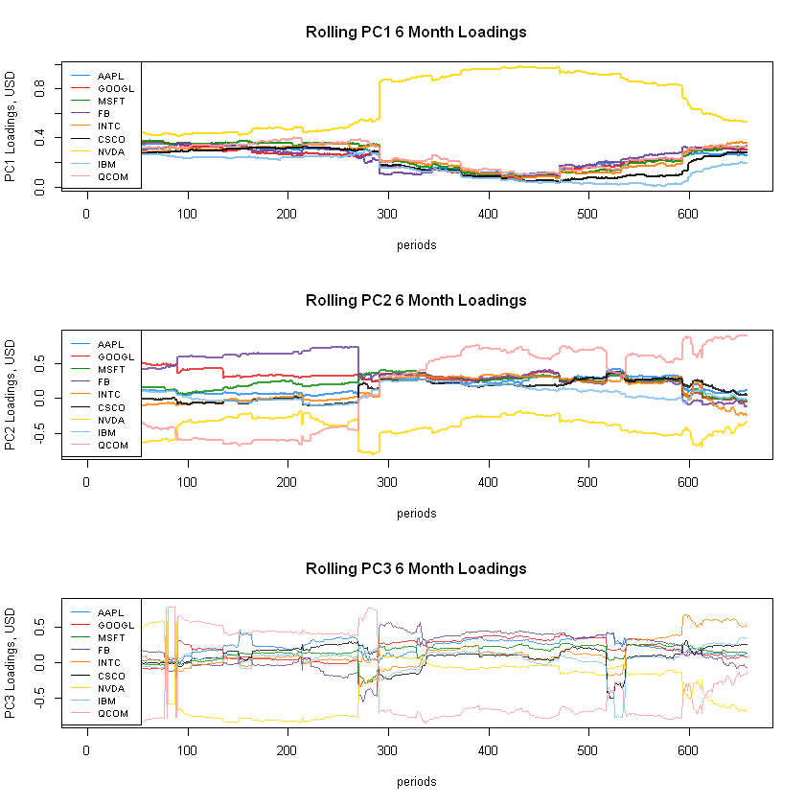
Technology Stocks - Stability

Slide 12
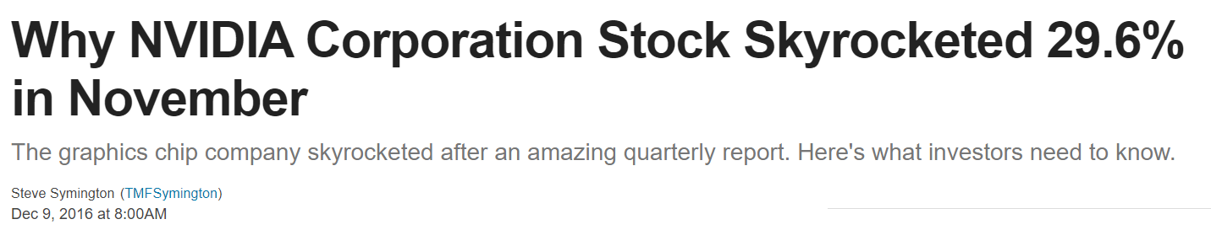
Technology Stocks - Stability

Slide 13
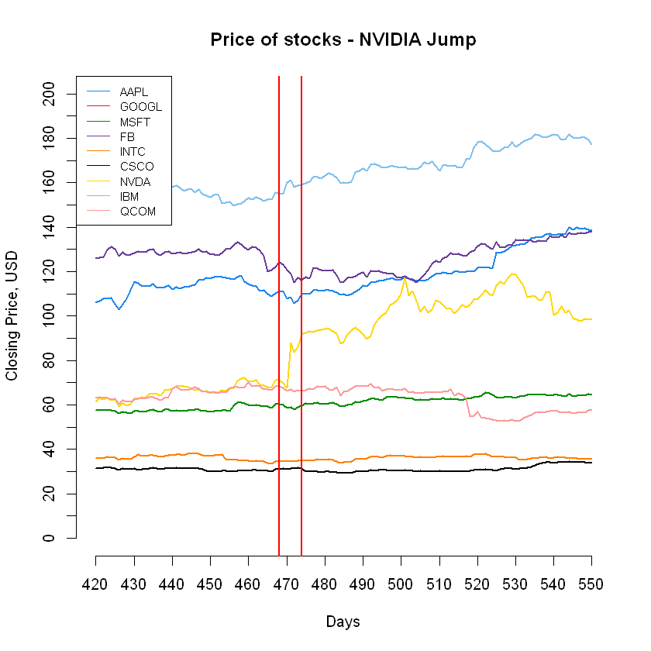
Technology Stocks - Stability

Slide 14
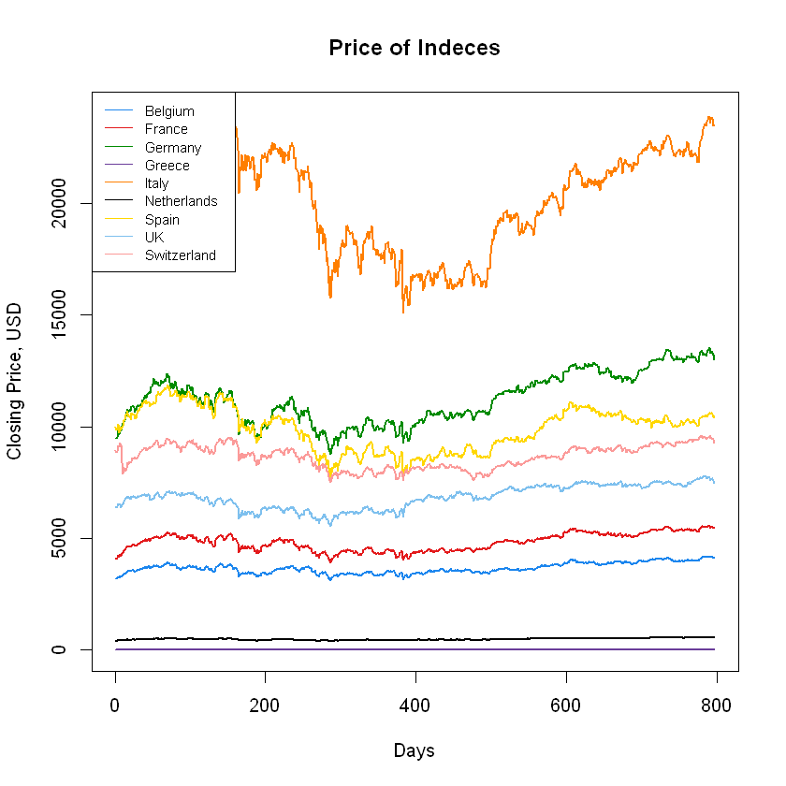
PCA Application 2 – European Indexes

Slide 15
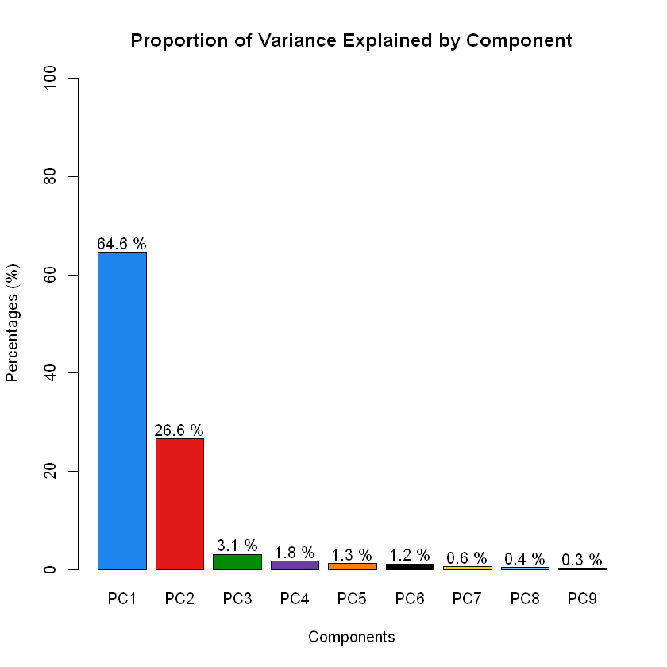
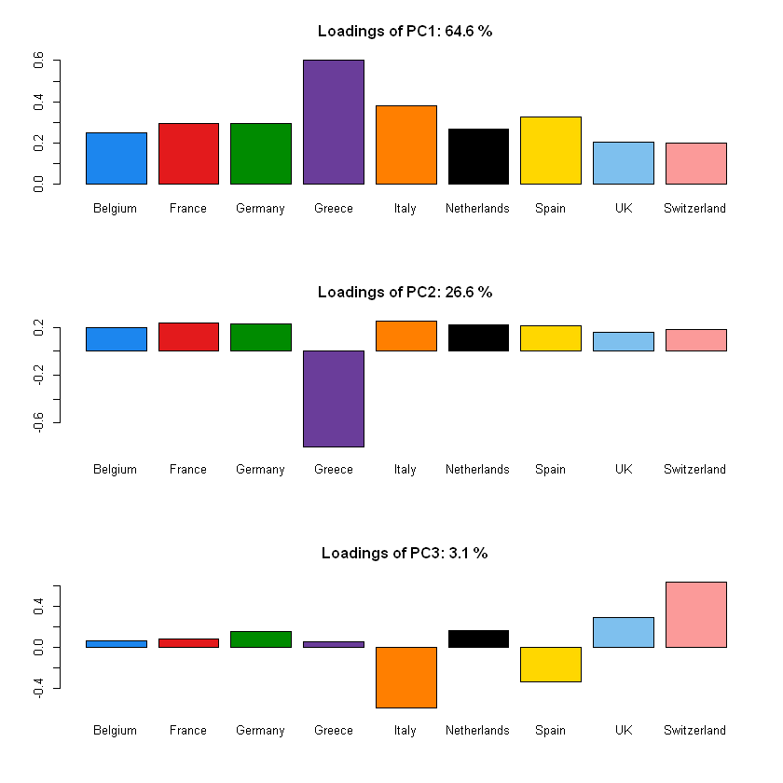
PCA Application 2 – European Indexes

Slide 16
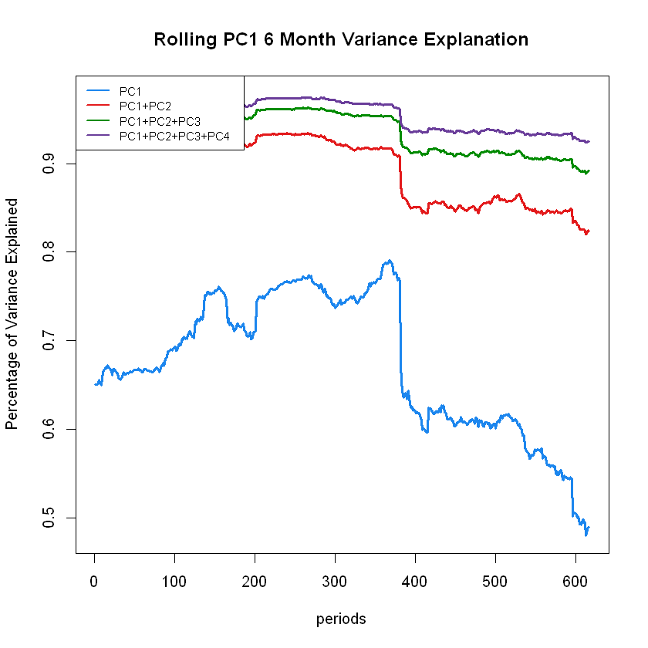
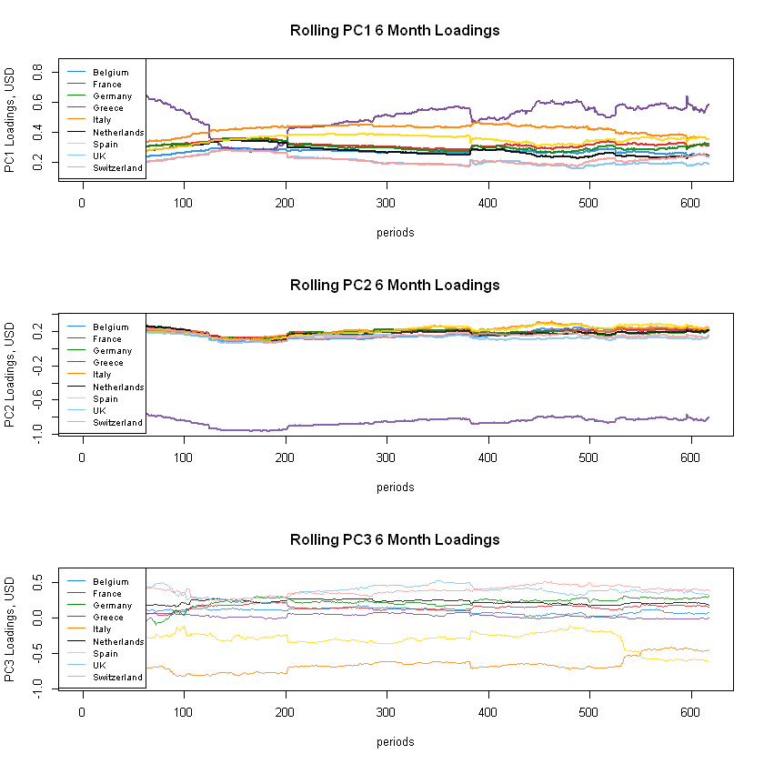
PCA Application 2 – Stability

Slide 17
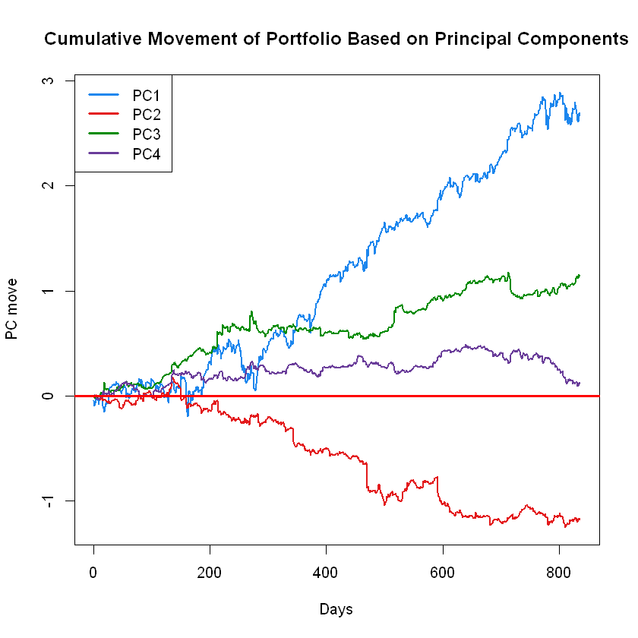
PCA Portfolios – Tech. Stocks

Slide 18
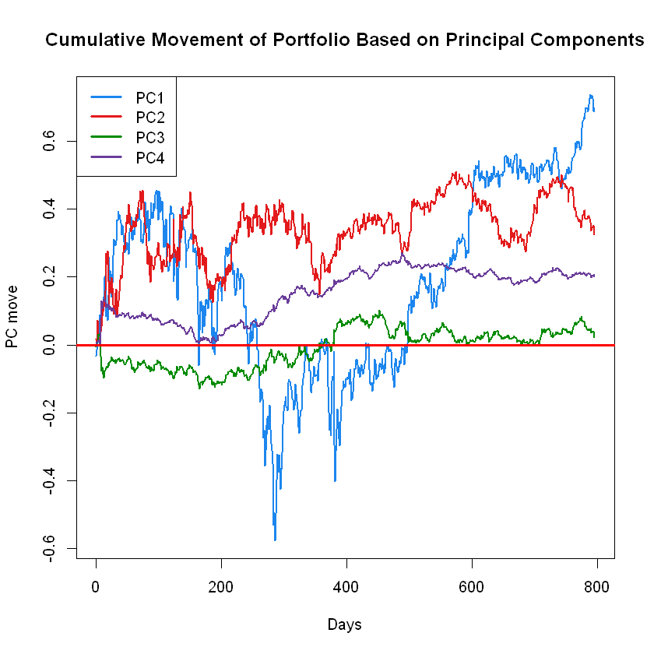
PCA Portfolios – EU Indexes

Slide 19
PCA Portfolios Generally
Various investment strategies Exposures & Risks
Suppose initial portfolio with weights V.
Minimize exposure to k-th component: V’ = V-(V*u_{k})u_{k}
PC_{k} -neutral portfolio
Minimimum volatility: project against last principal component
Maximum volatility: project against 1st principal component

Slide 20
Conclusion
Robust strategy
Helps with:
Data simplification & understanding
Risk reduction
Data compression
Two examples:
US technology companies
EU Market Indexes

